Slide 1
CANADA AIRLINE LOYALTY ACTIVITY
ANALYSIS |
Data Analysis - Final Project
NeuroTECH Academy | Instructor Eng. Bassam EL Shoraa
CATHERINE HABIB

Slide 2
DATASET OUTLINE
DESCRIPTION
TABLES
This Airline Dataset contains data from Canada Airline Loyalty History and Flights Activity.
The dataset consists of 3 different tables.
CALENDAR
CUSTOMER FLIGHT ACTIVITY
CUSTOMER LOYALTY HISTORY

Slide 3
KEY FINDINGS
Customer Loyalty History
from
table

Slide 4
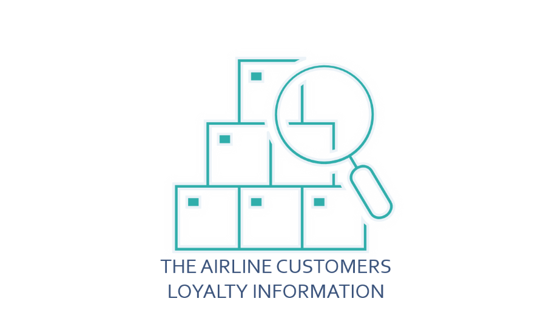
FINDING
S

Slide 5

THE AIRLINE CUSTOMERS LOYALTY INFORMATION

Slide 6
AIRLINE CUSTOMERS LOYALTY INFORMATION
CUSTOMERS NATIONALITY
The airline of this dataset provides services to customers coming from only 1 Country which is Canada from 11 different Provinces and 29 different Cities in Canada.
The dataset contains approximately 17K customers enrolled in the airline services (exactly 16,737 customers).

Slide 7


AIRLINE CUSTOMERS LOYALTY INFORMATION
CUSTOMERS GENDER DIVISION
Most customers are female gender.
50.25% are Female
49.75% are Male

Slide 8
AIRLINE CUSTOMERS LOYALTY INFORMATION
CUSTOMERS EDUCATION DIVISION
Note:
The Majority have a Bachelor’s degree !
There are 5 different degrees:
62.59% have a Bachelor’s degree.
25.32% have a College degree.
4.67% have a High School degree or Below.
4.39% have a Doctor degree.
3.04% have a Master’s degree.

Slide 9
AIRLINE CUSTOMERS LOYALTY INFORMATION
CUSTOMERS MARITAL STATUS
There are 3 categories:
58.16% are Married.
26.79% are Single.
15.04% are Divorced.
Note:
The Majority are Married!

Slide 10
AIRLINE CUSTOMERS LOYALTY INFORMATION
CUSTOMERS LOYALTY CARDS ENROLLMENTS AND CANCELATIONS
There are 3 types:
7,637 are enrolled in a Star Card, 901 of which were cancelled.
5,671 are enrolled in a Nova Card, 717 of which were cancelled.
3,429 are enrolled in an Aurora Card, 449 of which were cancelled.
Note:
The Majority have a Star Card!
All enrollments were between 2012 and 2018
&
All cancellations were between 2013 and 2018

Slide 11
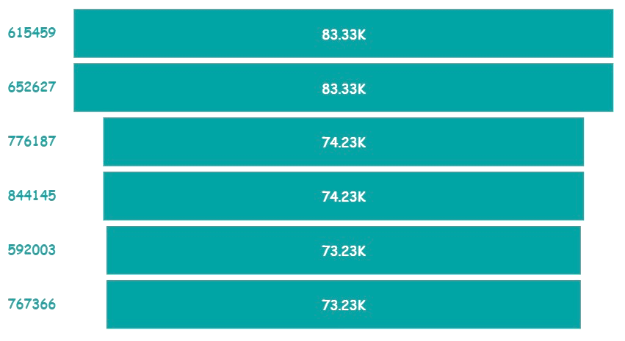
AIRLINE CUSTOMERS LOYALTY INFORMATION
CUSTOMERS CLV (CUSTOMER LIFETIME VALUE) RANGE
Ranges between 1,898.01 and 83,325.38.
Customers with the highest CLVs:
Note:
The Total of all CLVs measures approximately 133.71M!

Slide 12
KEY FINDINGS
Customer Flight Activity
from
table

Slide 13

FINDING
S

Slide 14
THE AIRLINE FLIGHTS ACTIVITY

Slide 15
AIRLINE FLGHTS ACTIVITY
FLIGHTS TOTAL NUMBER
All flights in this dataset were only in 2 years 2017 and 2018.
The dataset contains approximately 509K recorded flights (exactly 508,808 flights).
The total number of flights per customer ranges from 0 to 28 flights per month.
The average number of flights per customer ranges from 0 to 9 flights per month.

Slide 16
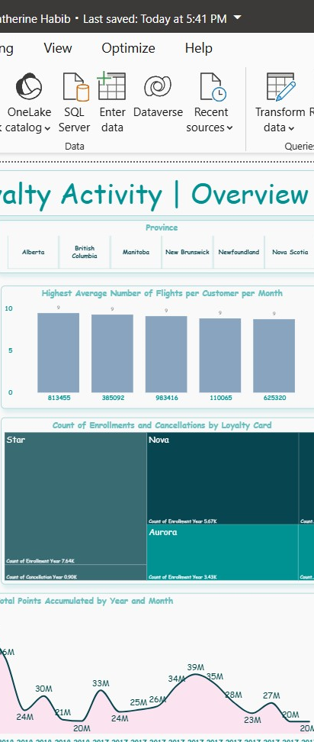
AIRLINE FLGHTS ACTIVITY
MOST TRAVELLING CUSTOMERS
The Highest Averages of Flights per Customer per Month:

Slide 17
AIRLINE FLGHTS ACTIVITY
TOTAL POINTS ACCUMULATED BY MONTH AND YEAR
The Highest Numbers of Points Accumulated were in July of each of both years 2017 and 2018 with approximately 39M and 64M, respectively.
Note: 2018 has the higher numbers of the accumulated points!
The total of the points accumulated in both years is approximately 796.55M.

Slide 18
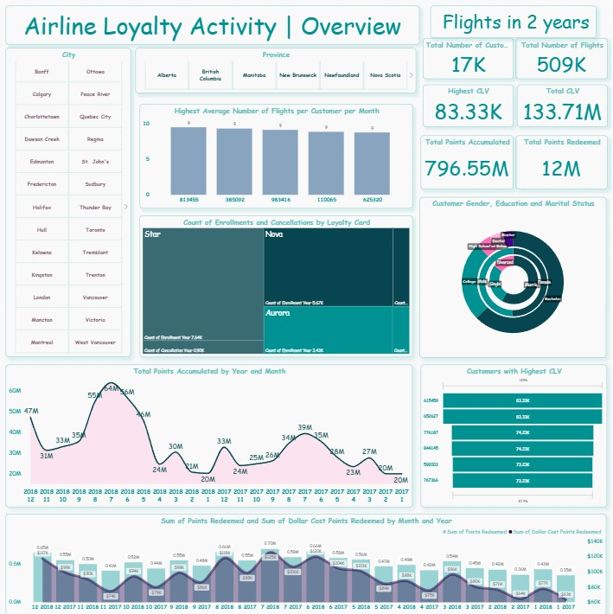
OTHER KEY FINDINGS
A lot of other findings can be derived from the dashboard.

Slide 19
THANK YOU !

